Slide 1
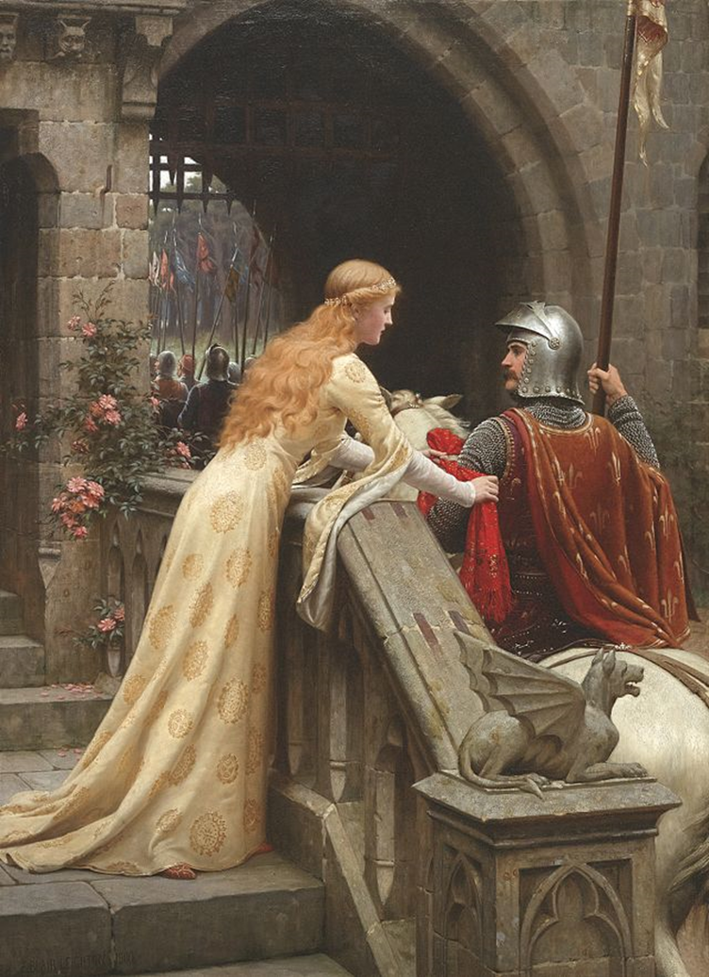
Wife of Bath
HIS 3723 – 001
Alvarez, Montserrat
Eubank, Seth
Hernandez, Karisa
Smith, Gabriel
Smith, Shawn

Slide 2
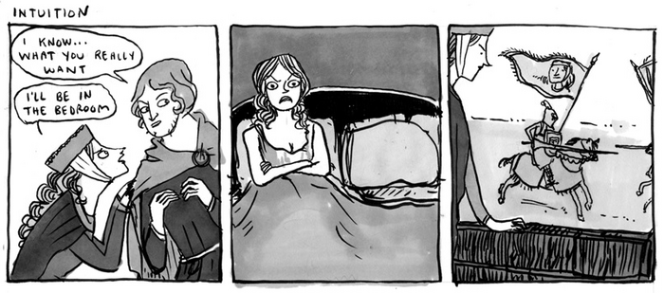
The Book of Wicked Women
“Whenever he had leisure and freedom
From any other worldly occupation
To read in it concerning wicked women:
He knew more lives and legends about them
Than there are of good women in the Bible.”

Slide 3
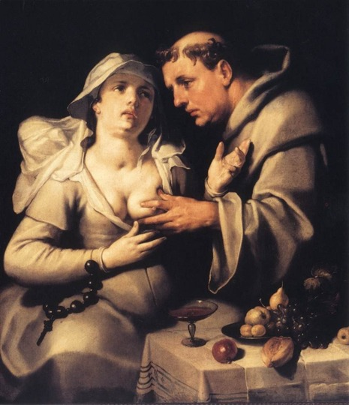
Fairies and Friars
Women may now go safely where they like:
In every bush, and under every tree,
They’ll find no other satyr there but he:
And he’ll do nothing worse than take their honour.

Slide 4
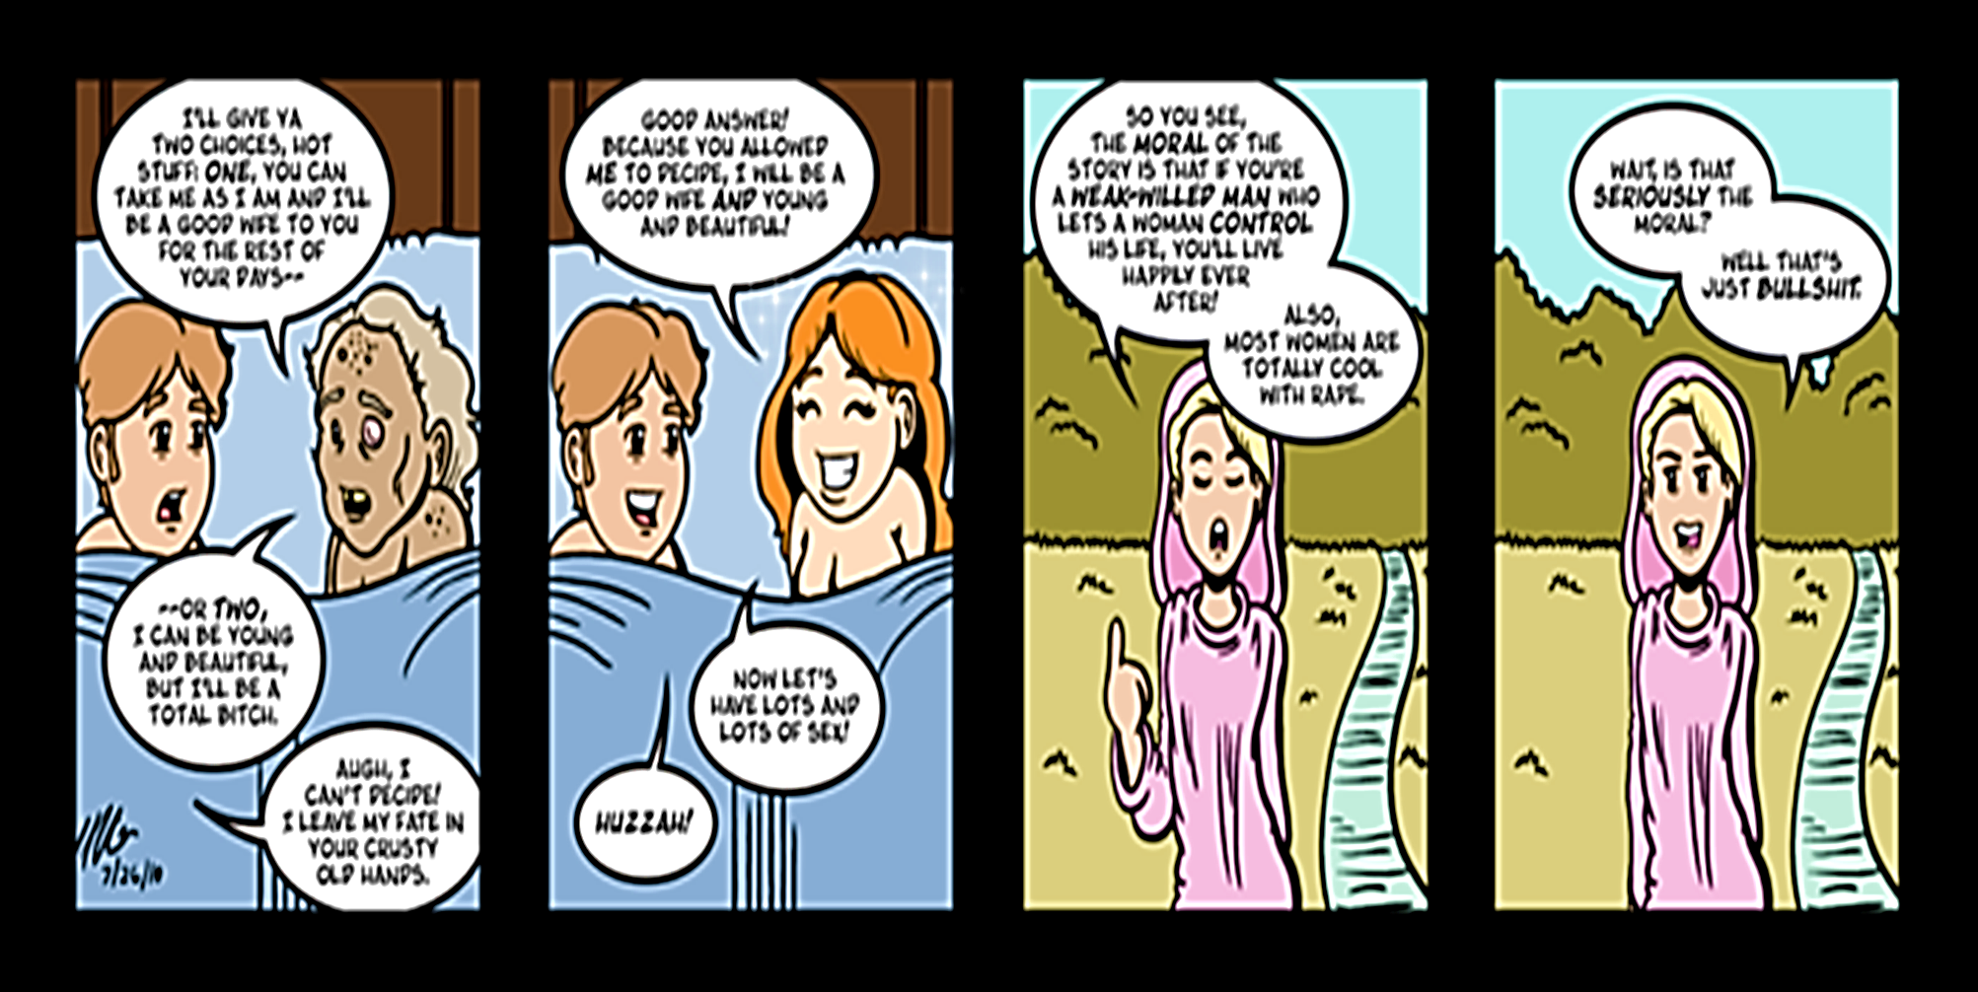
Needs of the Flesh
‘Choose now, choose one of these two things,’ said she, ‘To have me old and ugly till I die. And be to you a true and faithful wife, And never to displease you all my life; Or else to have me beautiful and young, And take your chances with a crowd of men

Slide 5
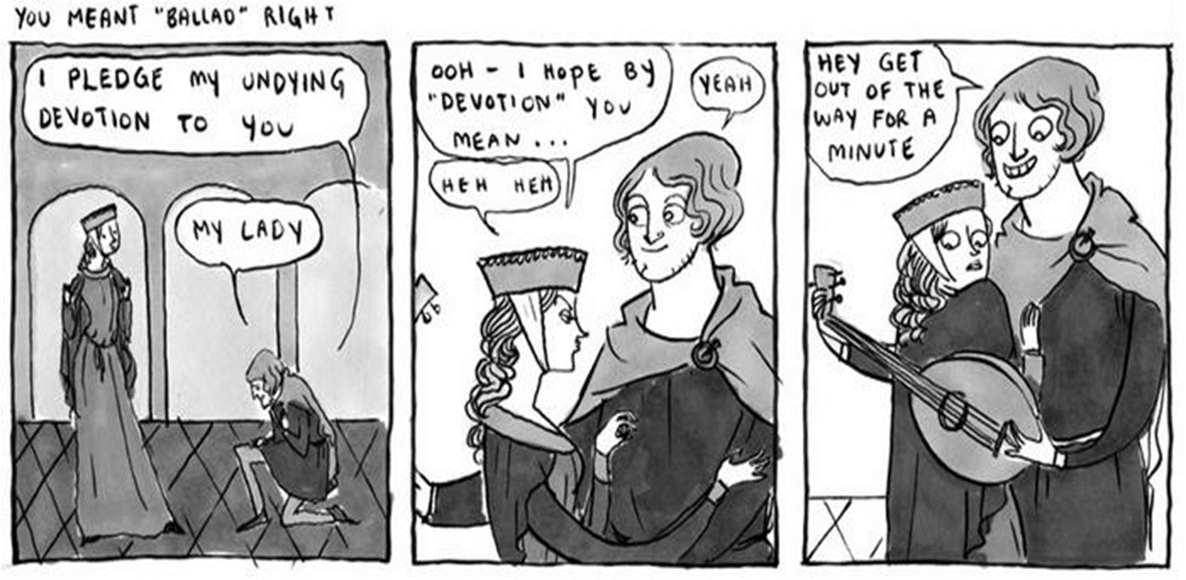
Meek Men
To their lives’ end they lived in perfect joy; And may Christ Jesus send us husbands who Are meek and young, and spirited in bed; And send us grace to outlive those we wed; And I pray Jesus to cut short the lives Of those who won’t be governed by their wives; And as for all old and ill- tempered skinflints, May heaven rain upon them pestilence!

