Slide 1

Alpha Kappa Psi PRESENTS
BUSINESS PROFESSIONAL VS. BUSINESS CASUAL
THE DO’S AND DONT’S

Slide 2
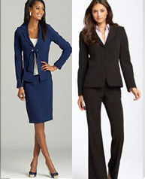
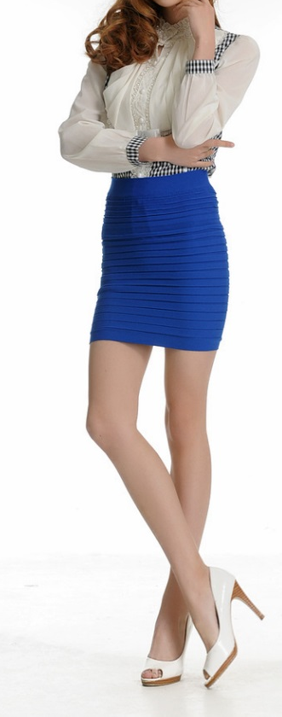
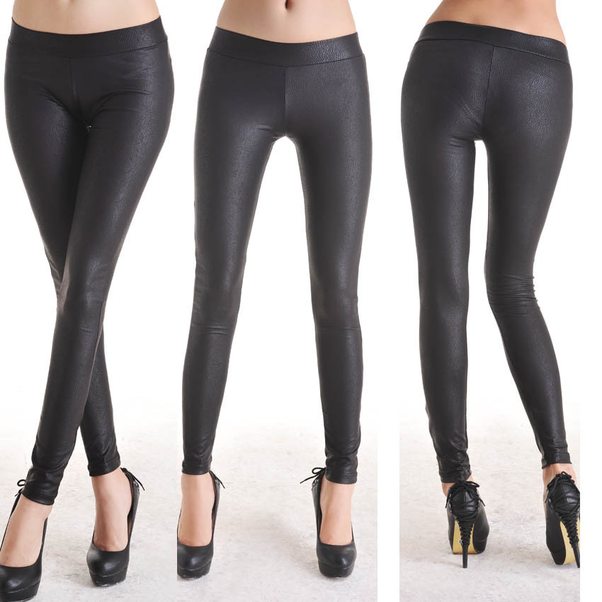
Women’s business professional
WEAR A SUIT (Skirt Suit or Pantsuit)
DO
Colors-solid or neutral
Wear hosiery with skirts
DON’T
Wear skirts above knee or that are too tight
Wear bright neon colors

Slide 3
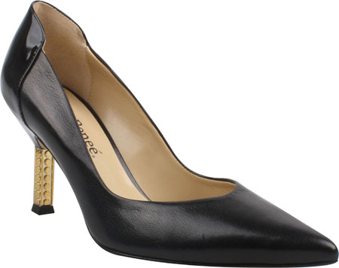
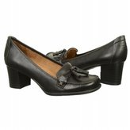
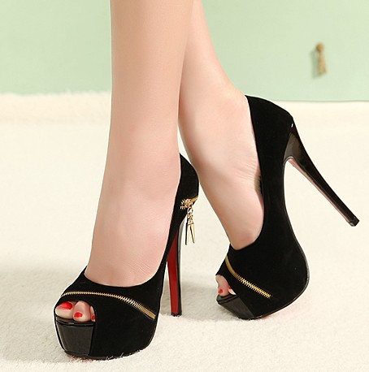
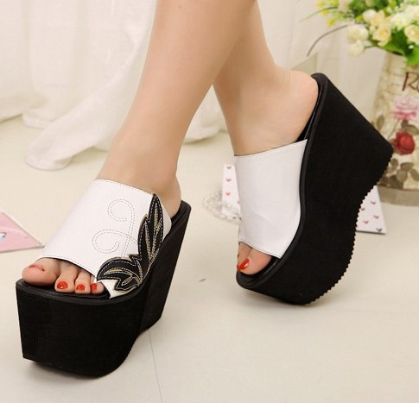
Women’s business professional
SHOES
DO’S
Classic leather pumps recommended
  - (1to 3 inch heels)
Colors: Navy, black, brown, or burgundy
DON’TS
NO open toe, flip flops, or sandals
NO stilettos, or heels with too much height

Slide 4
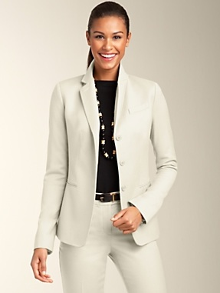
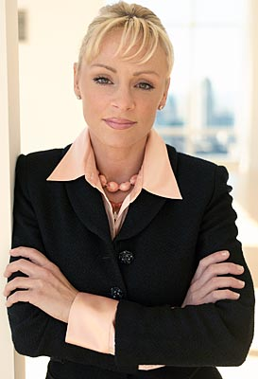
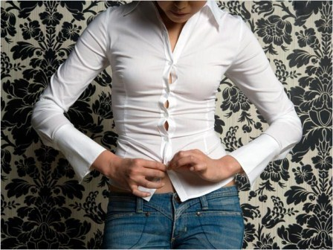
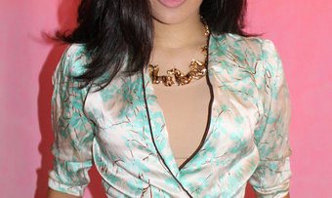
Women’s business professional
BLOUSES
DO
Tailored blouses with subtle print/color to match suit
Silk or cotton fabric with simple collar
DON’T
“too tight” or “revealing” fabric.
Avoid Plunging necklines

Slide 5
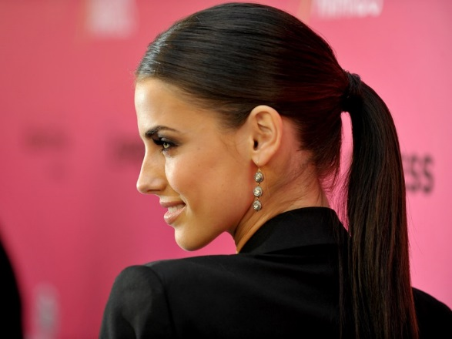
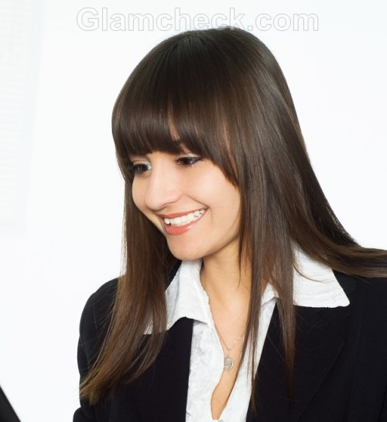
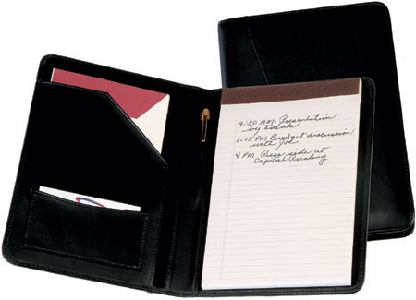
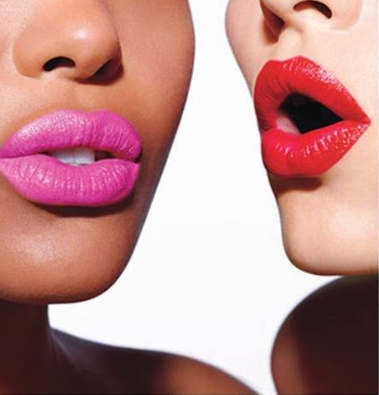
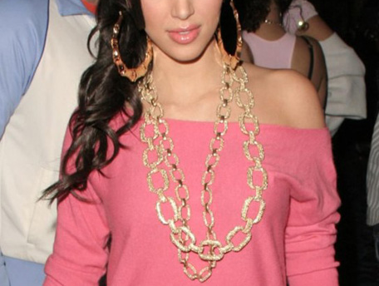
Women’s business professional
MAKEUP, HAIRSTYLE, & ACCESSORIES
DO
Clean and natural makeup & hair
Keep hair up and away from the face
Briefcase or portfolio (neutral color)
DON’T
Dangly jewelry/ distracting
Bright colored makeup
No bulky, bright bags or purses

Slide 6
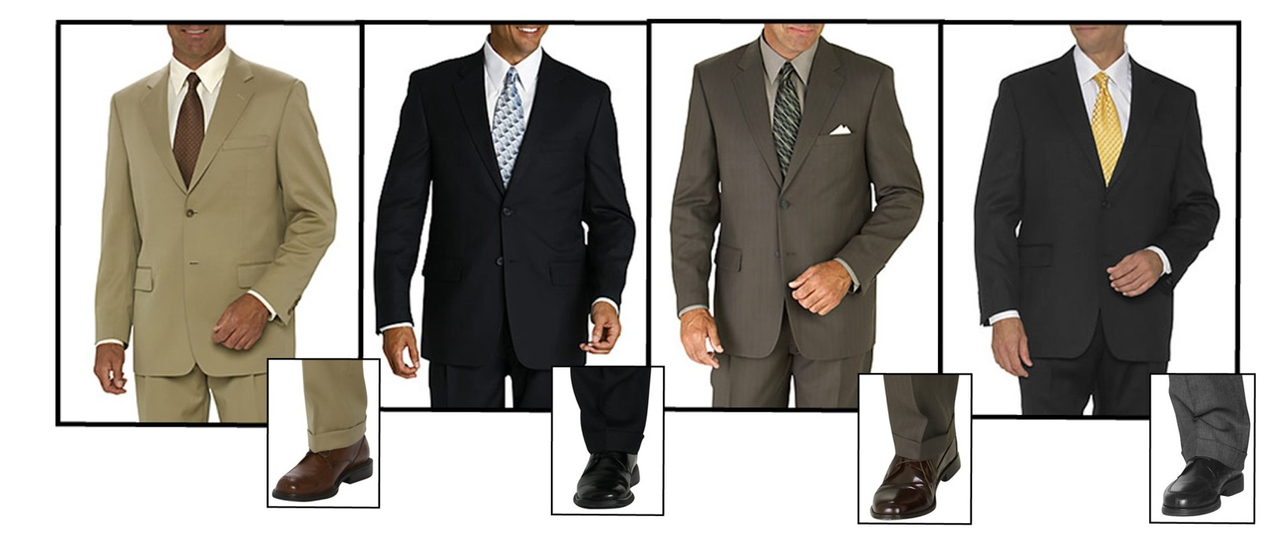
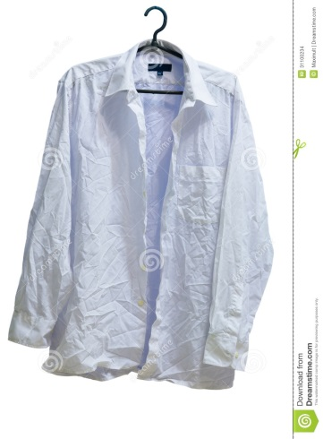
men’s business professional
BUSINESS SUIT
DO
Color: solid or neutral
Jackets with 2 or 3 buttons
DON’T
Button second button
Wrinkled under dress shirt

Slide 7
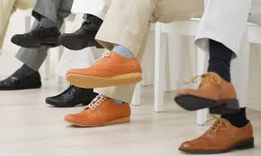
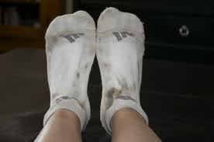
men’s business professional
DRESS SOCKS & SHOES
DO
At least calf high and match shoes
Stick with solid colors
Lace-up or slip on business shoes
DON’T
Avoid too short socks that show flesh
Sports socks
Sports shoes or sneakers

Slide 8
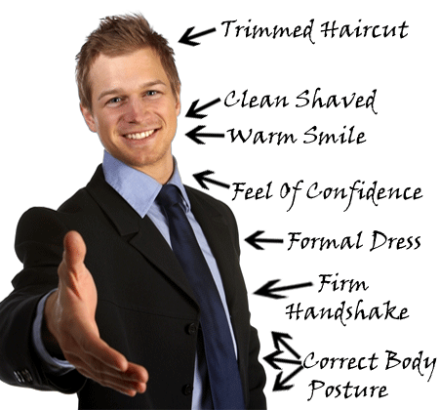
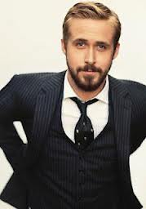
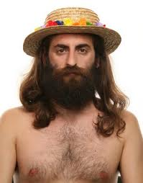
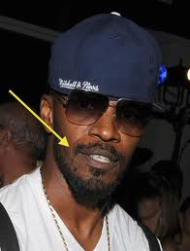
men’s business professional
HAIR & FACIAL HAIR
DO
Clean and well groomed
DON’T
Hair should not hang in your face

Slide 9
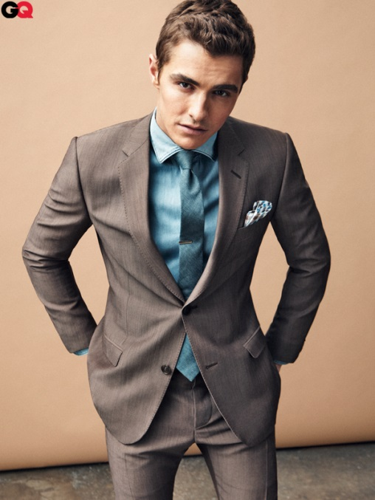
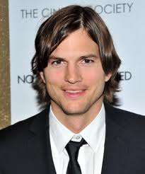
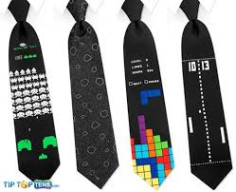
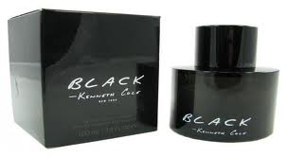
men’s business professional
TIE & COLOGNE
DO
Tie should have simple pattern or solid color
Blend well with suit
Wear light fragrance to coordinate season
  Spring months musky and spicy for winter (tip)
DON’T
Avoid character ties or busy prints
Strong cologne fragrance

Slide 10
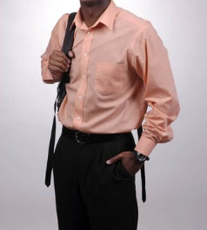
What IS BUSINESS CASUAL?
A crisp, neat, more relaxed version of “Professional Dress”
Should look appropriate for meeting with the CEO
NO cocktail party or picnic attire
Classic vs. trendy
NO piercings!

Slide 11
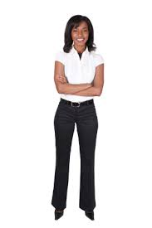
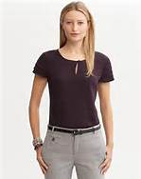
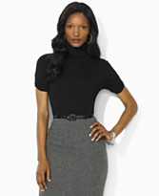
Women business CASUAL
DO
Neutral color
Moderate length dress or skirt
Casual pants
DON’T
Sleeveless top
Tight clothing
No open shoes
NO FACIAL PIERCINGS

Slide 12
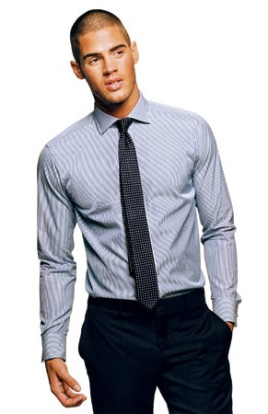
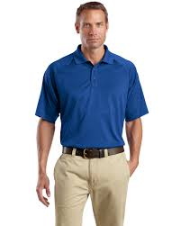
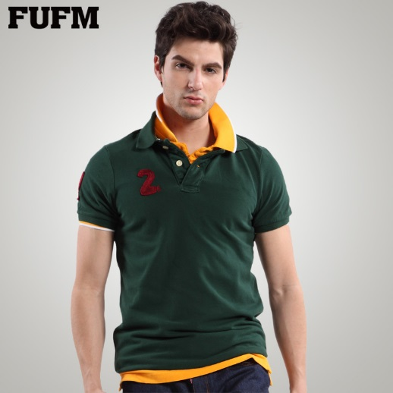
men business CASUAL
DO
Polo shirt
Shirt with collar/sweater
Khakis or dress pants
Tuck in shirt
DON’T
Wrinkled shirts
Cargo pants
Untuck shirts

Slide 13

When to dress business casual
Information sessions
Classroom or presentation settings
Evening sessions
Semi conservative workplace
Some interviews
WHEN IN DOUBT…ASK!!

Slide 14
THANK YOU!!

