Slide 1
Health Care Reform
How am I going to be affected?
Notes:
Why are we fixing it? How everyone else is doing it?

Slide 2
Why should we care? We are business majors…
Everyone needs healthcare
Knowing what healthcare is going gives you an upper hand when signing up for plans at 26.
Where healthcare is going will affect your wages
Everyone talks about it:---Hot topic with clients and business peers/boss

Slide 3
Why is it being fixed?
We spend more on health care ($2.9 trillion) than we do on food and petroleum making 17.2% of our GPD (highest in the world).
Hospital bills are the #1 reason for bankruptcy in this country
16% of Americans or 50 million are uninsured
Highest or near-highest prevalence infant mortality of heart and lung disease, sexually transmitted infections, adolescent pregnancies, injuries, homicides, and disability than any other high income country.
Notes:
WHO ranks US 37th in the world.

Slide 4
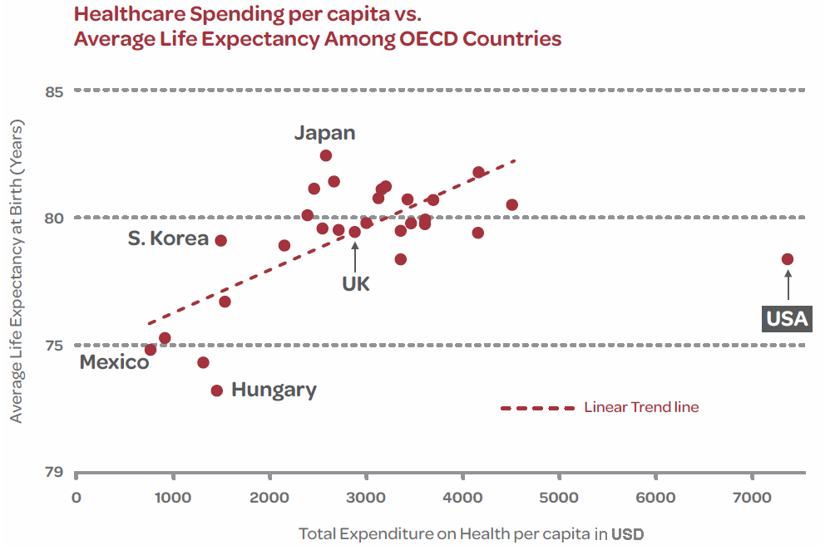

Slide 5
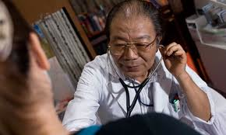
Japanese Health Care

Slide 6
What do they do better?
8.5% GPD
Longest Life expectancy in the world (83)
Everyone is covered; 30% by the people 70% by the government (sickness fund).
Virtually no financial distress for patients
Everyone has access to healthcare
Notes:
$3 for stiches, USA MRI $1500 v. Japan MRI $98, no penalty for not having insurance but only 10% take advantage of this.

Slide 7
What do they do worse?
Doctors are paid close to minimum wage* relative to the 60 hour work weeks.
50% of hospitals are in deficit.
Not as many specializations and licensure is less strict on doctors
Shortage of medical resources is common
Notes:
*2.2 doctors per 1000 v. USA 2.4 per 1000.

Slide 8
Great Britain

Slide 9
What do they do better?
Virtually free healthcare everywhere
No one is uninsured
One of the highest ranked primary and emergency care systems
8.4% GPD

Slide 10
What do they do worse?
Higher taxes
Waiting times for doctors is 4x longer than waiting times in the US
Very socialist

Slide 11
France

Slide 12
What do they do better?
Ranked #1 by WHO in terms of health care access and efficiency
Life expectancy 81
High patient success rates and low mortality rates
Mixed private and public care make it comparable to US system
99.9% are covered
Clever kinks*
Notes:
the more ill a person becomes, the less they pay* fixed rates*

Slide 13
What do we do better?
Physician compensation
More specialization
More available technology

Slide 14
What are the goals of reform?
Everyone able to afford health insurance
Won’t have to worry about going broke if you get sick
Bring down the cost of health care

Slide 15
Emergency Care
Law forces emergency hospitals to treat any and all patients regardless of income or insurance status
A lot of patients can’t pay and the costs are absorbed by the hospitals-inflating prices for those who CAN pay

Slide 16
If I work for a big company that comes out of my employers pocket, it doesn’t cost me at all right?
When your employer spends more on health care he has to spend less on your wages
Eventually employers will have to cut programs*
Notes:
14$ tissues

Slide 17
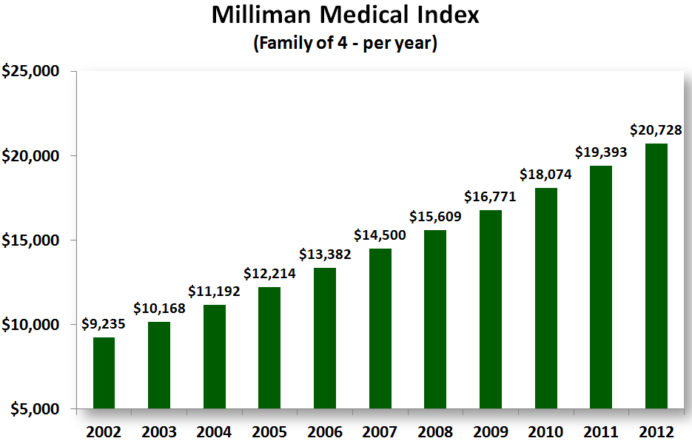
Notes:
Every U.S. family of 4 is paying the dollar equivalent of a new Chevy Cruze in healthcare costs. Every year. Without financing.

Slide 18
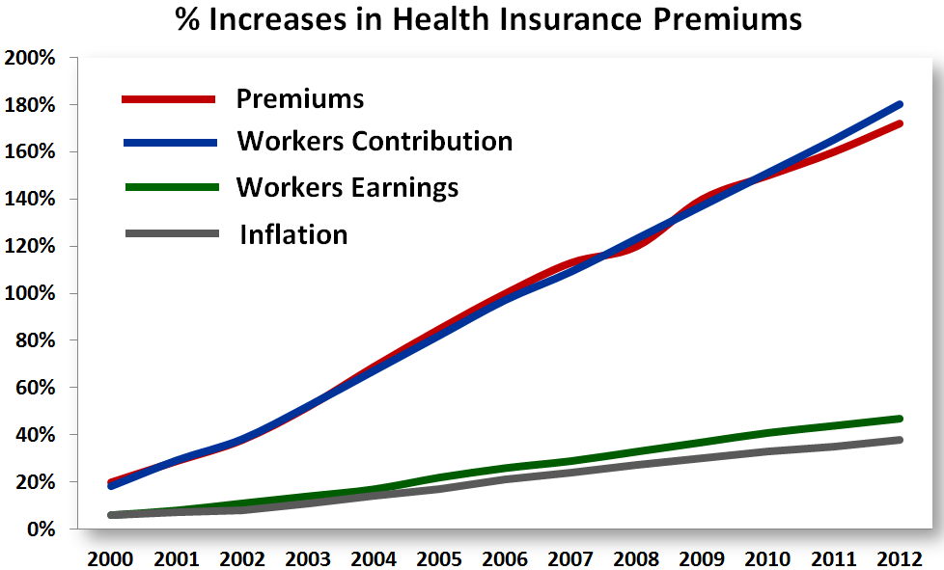

Slide 19
What is the difference b/w “Obamacare” and ACA?

